Slide 1
Website for Cornell Pakistani Students Association
By Cassidy McGovern, Kevin Wang, Aanya Samarasinghe, and TK Kong

Slide 2
Goal: to create an interactive, polished site for members and interested students of Cornell PSA to learn about the association and its events

Slide 3
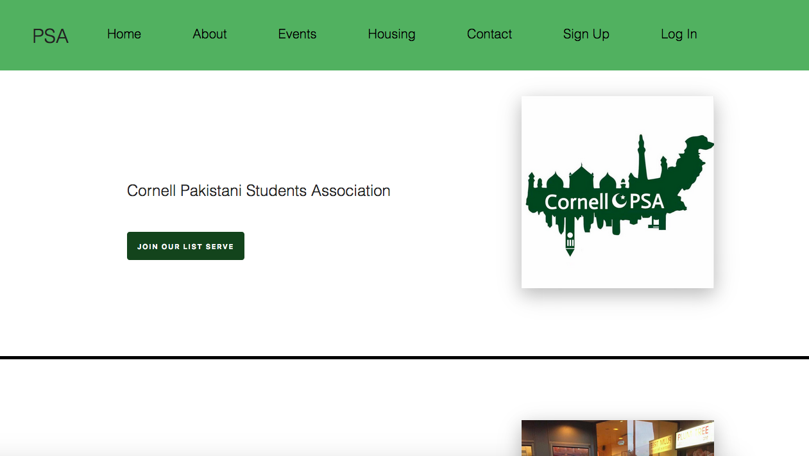

Slide 4
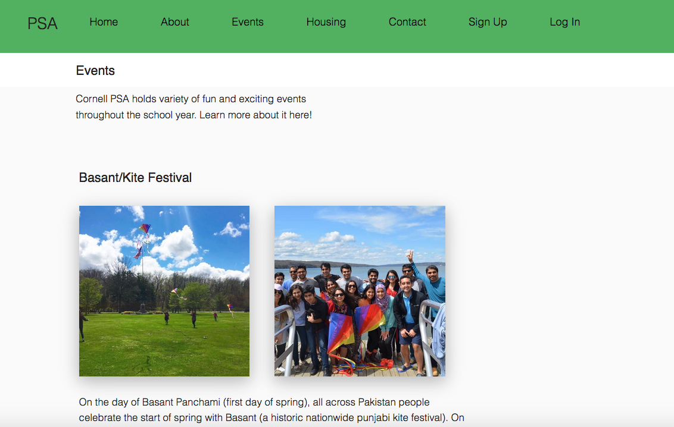

Slide 5
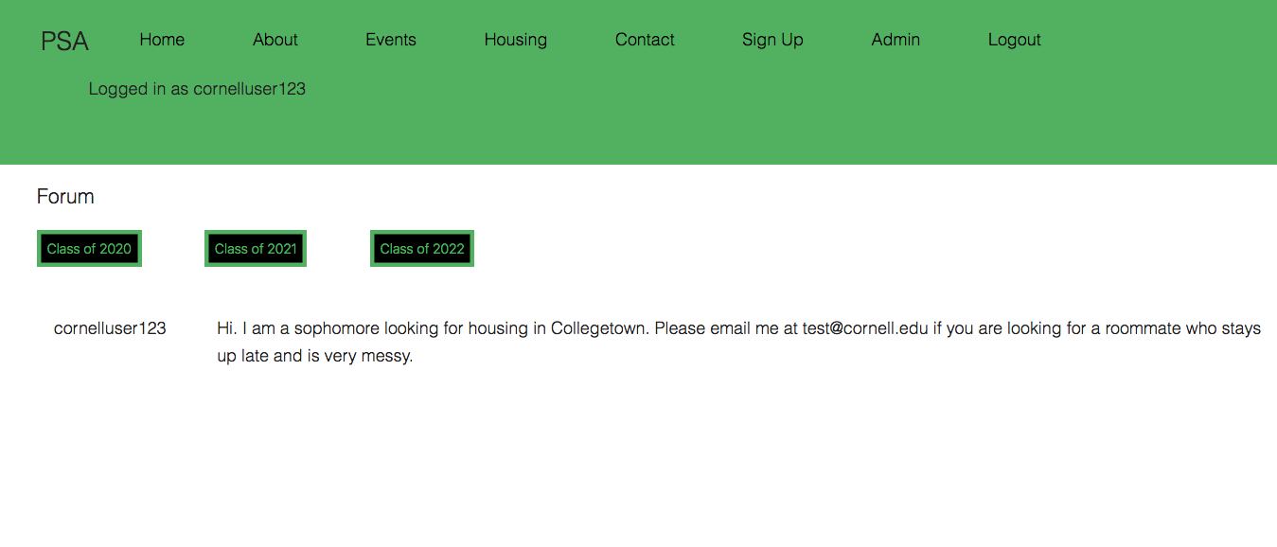
When a user is logged in, they can view posts by other members looking for housing

Slide 6
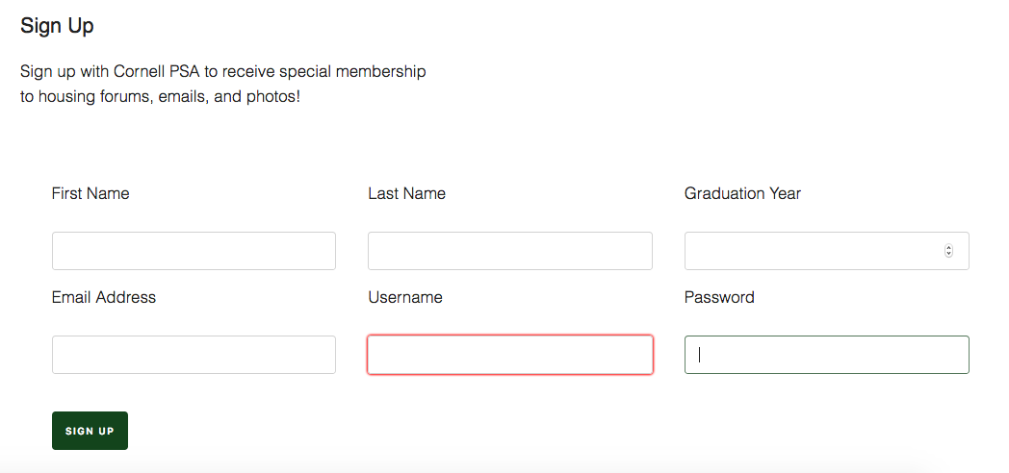
Interested students can sign up to request to become a member of the site

Slide 7
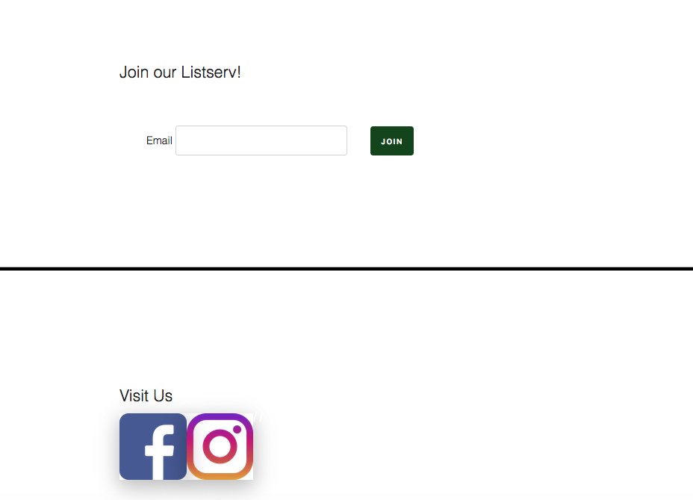
People who want to get updates about the PSA can enter their email here to join the listserv

